Slide 1
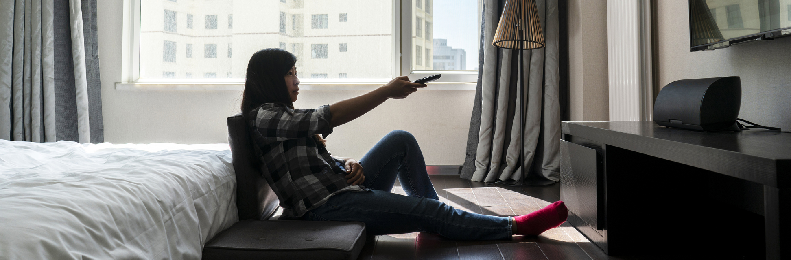
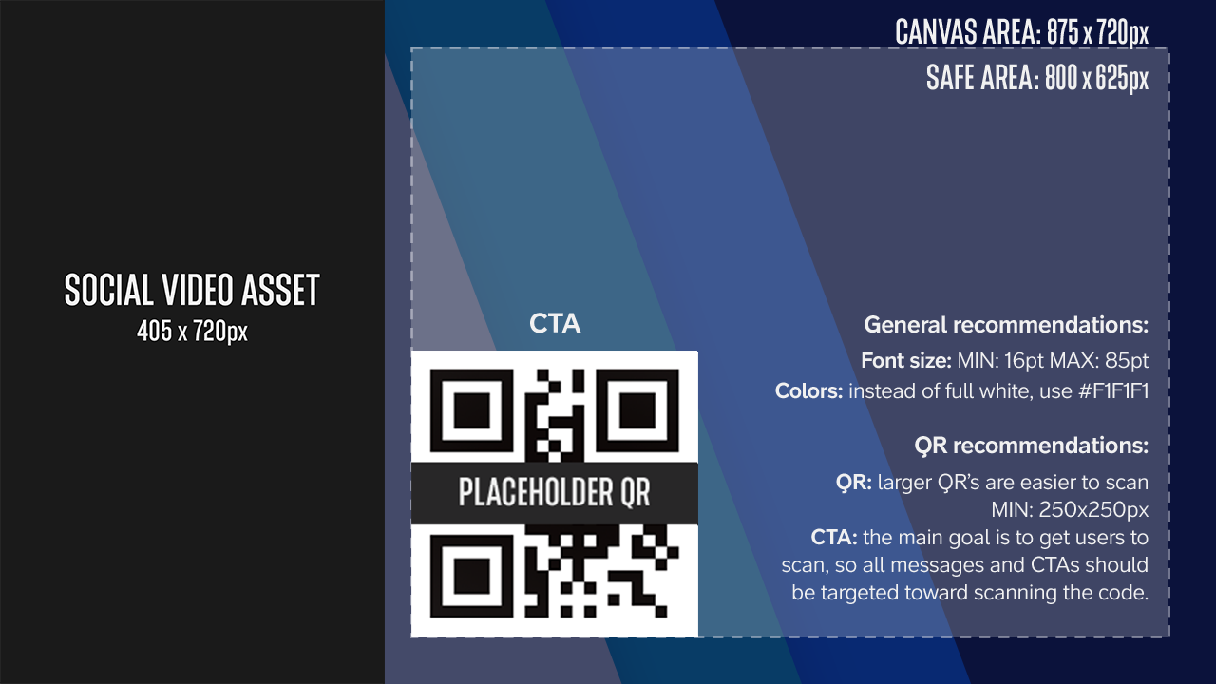
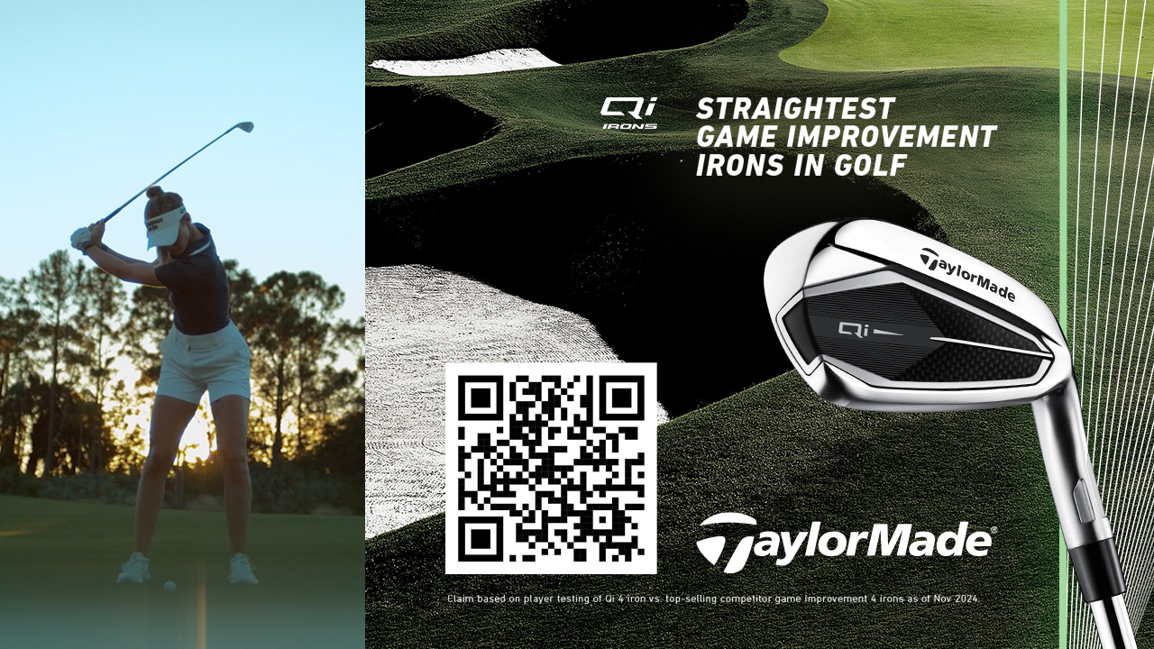
PARAMOUNT CTV
AD SPECIFICATIONS
1
DEFINITION
The Social to CTV ad format allows advertisers to repurpose social content for CTV use amplifying the video asset with custom branding to increase relevancy and engagement. Advertisers also have the option to feature a QR code to drive action.
CTV Ad Template:
1280x720
CTV Ad Example:
1280x720

Slide 2
2
TECHNICAL SPECIFICATIONS:
Style Guide & Technical Specifications:
The CTV Ad allows an advertiser to house their Social video (9:16) creative within a static canvas or skin. The video must be site served and meet Paramount Site Served Video Specs. The video ad and static creative are both visible for the whole duration of the video.
If including a QR code, it must be a minimum of 250x250 pixels in order to be easily scanned from a standard couch to TV distance. QR code will be supplied by Paramount.
ITEM
SPECIFICATION
CTV AD Dimensions
Video dimensions: 405 x 720px
Canvas area: 875h x 720 px
Design safe area: 800 x 625px
DOWNLOAD THE PSD TEMPLATE:
CTV Ad PSD Template
In the PSD, please design within the ‘DESIGN HERE’ smart object, leave video placeholder blank.
QR code is optional, you can turn off the
QR code layer in the template
Maximum File Size
10 GB
File Format
.mp4 (H.264 High Profile) (preferred)
.mov (Apple ProRes 422 or Apple ProRes 422HQ)
Third Party Tracking
Paramount Hosted and Served
1x1 impression and click tracking accepted
DELIVERABLES:
QR CODE REQUIREMENTS:
Clients can provide a design mock using our PSD template + video file
If template can’t be filled out the following assets are needed
  hero image (875h x 720px jpg or png)
  product images
  brand guidelines
  fonts
  logo file (eps, ai, psd, png)
  Headline Copy
QR code is provided by Paramount, using advertiser’s URL of choice
Minimum QR code size: 250x250 px
High contrast on a white background
VIDEO REQUIREMENTS:
Video Requirements:
The video must be site served and meet Paramount Site Served Video Specs
Page 3 of 4

Slide 3
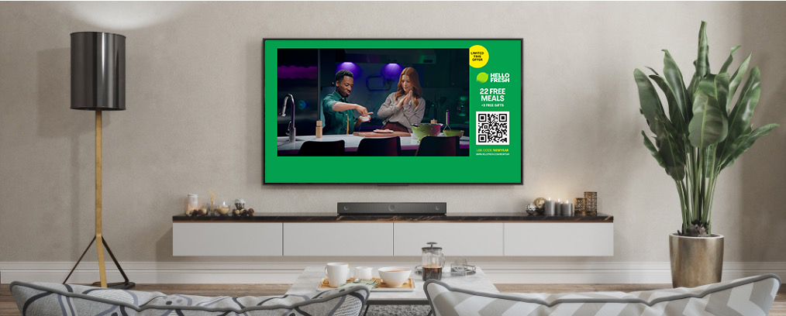
Platform
Ad Unit
Name
Dimensions
(WxH in pixels)
Max File Weight
Animation
3rd
Party
Image
Rotation
Image
File
HTML 5
Initial
Polite
Desktop
Superleader
970x66px
50KB
200KB
2MB
30 SEC MAX
YES
6 MAX
PER CAMPAIGN
Desktop
Leaderboard
728x90px
50KB
200KB
2MB
30 SEC MAX
YES
6 MAX
PER CAMPAIGN
DIGITAL AD
EXAMPLE
Desktop
Billboard
970x250px
50KB
200KB
2MB
30 SEC MAX
YES
6 MAX
PER CAMPAIGN
Desktop
Medium
Rectangle
300x250px
50KB
200KB
2MB
30 SEC MAX
YES
6 MAX
PER CAMPAIGN
Desktop
Skyscraper
160x600px
50KB
200KB
2MB
30 SEC MAX
YES
6 MAX
PER CAMPAIGN
Desktop
Half-Page
300x600px
50KB
200KB
2MB
30 SEC MAX
YES
6 MAX
PER CAMPAIGN
3
SUBMISSION INSTRUCTIONS AND DEADLINE INFORMATION
Mobile
320x50px
15KB
200KB
N/A
30 SEC MAX
YES
6 MAX
PER CAMPAIGN
Mobile
Banner
6 MAX
PER CAMPAIGN
SUBMISSION INSTRUCTIONS:
Please submit the Photoshop PSD template to your Paramount Account Manager. If you are unable to build the ad to spec, Paramount’s Brand Studio Team can build the ad using the client's creative direction and assets. Final development of the ad unit must take place at Paramount as this unit is site served only. QR Code will be supplied by Paramount.
.
DEADLINES:
If your client has questions about the specs and/or the PSD template, a representative from Paramount’s Brand Studio Team can meet with them to answer any questions. This call should be set up by the Paramount Sales Account Manager at least 10 days prior to launch. If the submitted creative does not conform to the above specifications, it will not be placed online and may result in a delayed launch date.
Mobile
300x50px
15KB
200KB
N/A
30 SEC MAX
YES
Mobile
Medium
Rectangle
300x250px
50KB
200KB
N/A
30 SEC MAX
YES
6 MAX
PER CAMPAIGN
Tablet
Tablet
(Portrait)
768x90px
50KB
200KB
2MB
30 SEC MAX
YES
6 MAX
PER CAMPAIGN
Tablet
Tablet
(Landscape)
1024x90px
50KB
200KB
2MB
30 SEC MAX
YES
6 MAX
PER CAMPAIGN
Desktop
& Mobile
Promo Unit
120x60px
15KB
N/A
30 SEC MAX
YES
6 MAX
PER CAMPAIGN
Desktop
& Mobile
Promo Unit
200x31px
15KB
N/A
30 SEC MAX
YES
6 MAX
PER CAMPAIGN
Submission Deadlines:
Image File - 2 business days prior to launch date
HTML 5 Standard Animation - 3 business days prior to launch date
HTML 5 Rich Media - 5 business days prior to launch date
Note: If the submitted creative does not conform to the specifications, it will not be placed online and may result in a delayed launch date.
Accepted File Types/Formats:
Site-Served - JPG, PNG, GIF, HTML 5
Third-Party - Javascript, iframe, Internal Redirect
All creatives must function uniformly on both Windows and Mac OS X operating systems as well as the following browsers:
Google Chrome, Firefox, Microsoft Edge and Safari for Mac OS X.
If the rich media creatives will not display properly in a browser,
a default GIF/JPG must be shown.
Page 4 of 4

